Slide 1

UX and Wireframing 101
Virginia tech

Slide 2
Agenda
1
Opening Discussion
UX and HCD
2
Defining UX Design
--
3
Systems Thinking
--
4
Design Timeline
In theory, waterfall and agile
5
Wireframing
The difference between wireframes, sketches and mockups
6
Activity
Sketching Crazy 8’s
7
Q&A
--

Slide 3
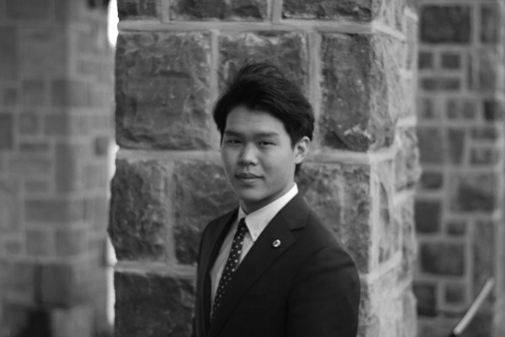


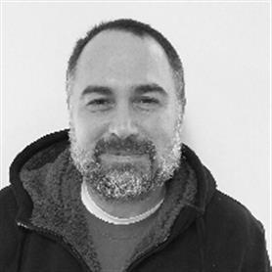
Our team
Introductions
Josh Kim
UX Designer
Contact: JoshKim@Deloitte.com
Kaitlin Kallini
Senior UX Designer
Contact: kkallini@Deloitte.com
Mary Buckingham
Business Technology Analyst
Contact: mabuckingham@deloitte.com

Slide 4
Think Fast!
Defining UX Design
--
What is your definition of User Experience
Or, how would you describe what UX is to someone else?

Slide 5
Think Fast!
Defining UX Design
--
What is your definition of User Experience
Or, how would you describe what UX is to someone else?
”User Experience” (UX) encompasses all aspects of the end-user’s interaction with the company, its services, and its products.
Nielsen Norman Group

Slide 6
Think Fast!
Defining UX Design
--
What is your definition of User Experience
Or, how would you describe what UX is to someone else?
The totality of the effect felt by the user as a result of an interaction with something including the influence of usability, usefulness, and emotional impact both during and after the interaction.
Rex Hartson

Slide 7
Think Fast!
Defining UX Design
--
What about Human-Centered Design (HCD)?
Or, how can you logically apply the definition of UX in broader terms?

Slide 8
Think Fast!
Defining UX Design
--
What about Human-Centered Design (HCD)?
Or, how can you logically apply the definition of UX in broader terms?
Human-Centered Design (HCD) puts people first. It is a methodology that drives toward solutions based on the voices and needs of users and, in doing so, helps focus efforts and investments towards the most meaningful and necessary innovations. By approaching challenges through research and evidence, we can better target solutions that are desirable, feasible, and viable.

Slide 9
The Core of HCD
Defining UX Design
Have you heard these words used interchangeably– in practice, each require UX
User Experience (UX) Design
The design and development of a single customer touch point
Customer Experience (CX)
The design and implementation of all touch points across all channels and the entire customer journey
UX
Service Design (SD)
Includes all previous as well as behind-the-scenes activities that enable those experiences to be delivered as intended
CX
SD

Slide 10
UX in Practice
Defining ux design
--
Desirable
What do our users
want and/or need?
Viable
What is practical for
our business?
The HCD Approach
By approaching challenges through research and evidence, we can better target solutions that are desirable, feasible, and viable.
Feasible
What is technically possible for our technology team?

Slide 11
UX Roles
Defining ux design
UX is an umbrella term which contains several implicit skills/positions on a team
Under the Umbrella of
User Experience Design
User Researcher
Owns research strategy
Conducts usability studies, interviews, surveys
Performs heuristic evaluations
Builds personas, journey maps
Represents Voice of Customer
Business Analyst
Understands business strategy, objectives
Articulates/clarifies business objectives
Ensures business value is defined
Represents Voice of Business
Visual Designer
User interfaces
Brand strategy
Style Tiles and guide
Color theory, Typography, Accessibility
Front-end Dev.
Code to implement design (from visual and interaction designers)
Front-end frameworks, HTML, JS, CSS, etc.
Native OS features
Info. Architect
Person-logical architectures
Navigation, organization, and search schemas
Data/info. taxonomies
Content Strategist
Content mapping, development, organization
Copy editing
Communication strategy
UX Strategist
Assessment and Vision
Objectives and planning
Measurement and execution
Interaction Designer
Interaction modeling
Mental modeling
Storyboards, journey maps, wireframes, user interfaces.

Slide 12
UX Roles
Defining ux design
UX is an umbrella term which contains several implicit skills/positions on a team
Under the Umbrella of
User Experience Design
Josh
User Researcher
Owns research strategy
Conducts usability studies, interviews, surveys
Performs heuristic evaluations
Builds personas, journey maps
Represents Voice of Customer
Business Analyst
Understands business strategy, objectives
Articulates/clarifies business objectives
Ensures business value is defined
Represents Voice of Business
Visual Designer
User interfaces
Brand strategy
Style Tiles and guide
Color theory, Typography, Accessibility
Front-end Dev.
Code to implement design (from visual and interaction designers)
Front-end frameworks, HTML, JS, CSS, etc.
Native OS features
Info. Architect
Person-logical architectures
Navigation, organization, and search schemas
Data/info. taxonomies
Content Strategist
Content mapping, development, organization
Copy editing
Communication strategy
UX Strategist
Assessment and Vision
Objectives and planning
Measurement and execution
Interaction Designer
Interaction modeling
Mental modeling
Storyboards, journey maps, wireframes, user interfaces.

Slide 13
UX Roles
Defining ux design
UX is an umbrella term which contains several implicit skills/positions on a team
Under the Umbrella of
User Experience Design
Josh
Kaitlin
User Researcher
Owns research strategy
Conducts usability studies, interviews, surveys
Performs heuristic evaluations
Builds personas, journey maps
Represents Voice of Customer
Business Analyst
Understands business strategy, objectives
Articulates/clarifies business objectives
Ensures business value is defined
Represents Voice of Business
Visual Designer
User interfaces
Brand strategy
Style Tiles and guide
Color theory, Typography, Accessibility
Front-end Dev.
Code to implement design (from visual and interaction designers)
Front-end frameworks, HTML, JS, CSS, etc.
Native OS features
Info. Architect
Person-logical architectures
Navigation, organization, and search schemas
Data/info. taxonomies
Content Strategist
Content mapping, development, organization
Copy editing
Communication strategy
UX Strategist
Assessment and Vision
Objectives and planning
Measurement and execution
Interaction Designer
Interaction modeling
Mental modeling
Storyboards, journey maps, wireframes, user interfaces.

Slide 14
UX Roles
Defining ux design
UX is an umbrella term which contains several implicit skills/positions on a team
Under the Umbrella of
User Experience Design
Josh
Kaitlin
Mary
User Researcher
Owns research strategy
Conducts usability studies, interviews, surveys
Performs heuristic evaluations
Builds personas, journey maps
Represents Voice of Customer
Business Analyst
Understands business strategy, objectives
Articulates/clarifies business objectives
Ensures business value is defined
Represents Voice of Business
Visual Designer
User interfaces
Brand strategy
Style Tiles and guide
Color theory, Typography, Accessibility
Front-end Dev.
Code to implement design (from visual and interaction designers)
Front-end frameworks, HTML, JS, CSS, etc.
Native OS features
Info. Architect
Person-logical architectures
Navigation, organization, and search schemas
Data/info. taxonomies
Content Strategist
Content mapping, development, organization
Copy editing
Communication strategy
UX Strategist
Assessment and Vision
Objectives and planning
Measurement and execution
Interaction Designer
Interaction modeling
Mental modeling
Storyboards, journey maps, wireframes, user interfaces.

Slide 15
Applying Systems Thinking
When designing we must understand that the behavior of people depends on the situation.
Interconnection
Changing one element can effect others. “Improving only the technology does not necessarily improve the performance of the overall system. Technology must work with people.”
Adaptation
“Technology often has unanticipated consequences that result from people adapting and changing their behavior in response to the technology”
Environment
Surroundings influence and guide our behavior. “Good design is contingent on the environment in which a person uses it.”
Material From:
Designing for People: An Introduction to Human Factors
Lee, Wickens, Liu, Boyle
Notes:
Thorough systems thinking considers Interconnection, Adaptation, and Environment in the final solution

Slide 16
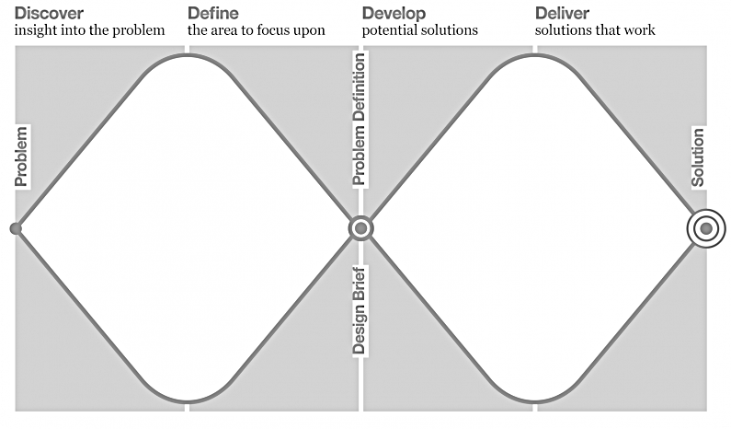
“Double Diamond”
TIMELINE
Start with an idea, and through the initial design research, expand the thinking to explore the fundamental issues. Only then is it time to converge upon the real, underlying problem. Similarly, use design research tools to explore a wide variety of solutions before converging upon one.
British Design Council, 2005
Repeated divergence and convergence is important in properly determining the right problem to be solved and then the best way to solve it.

Slide 17
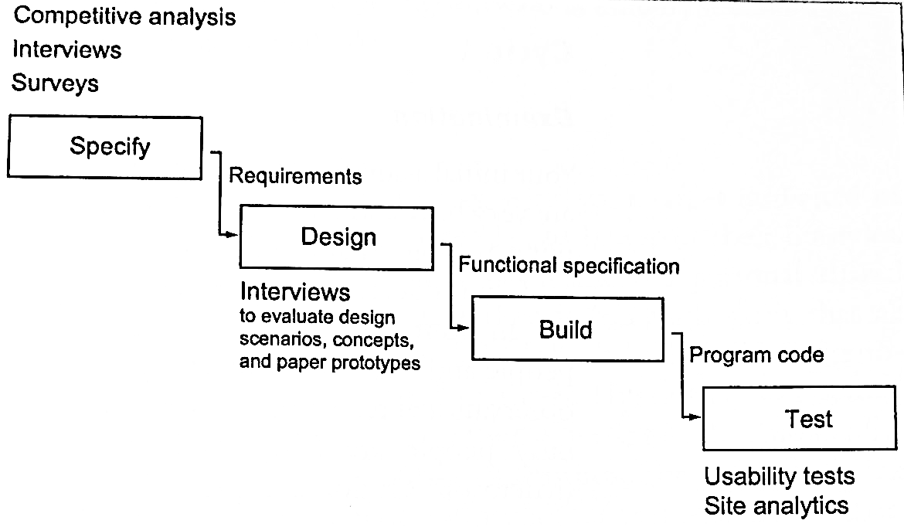
Design in Waterfall
TIMELINE
In a waterfall process, user research typically happens at the beginning and end- before the requirements are written, and then after some code is written.
More early, research activities exist before implementation to minimize risk.

Slide 18
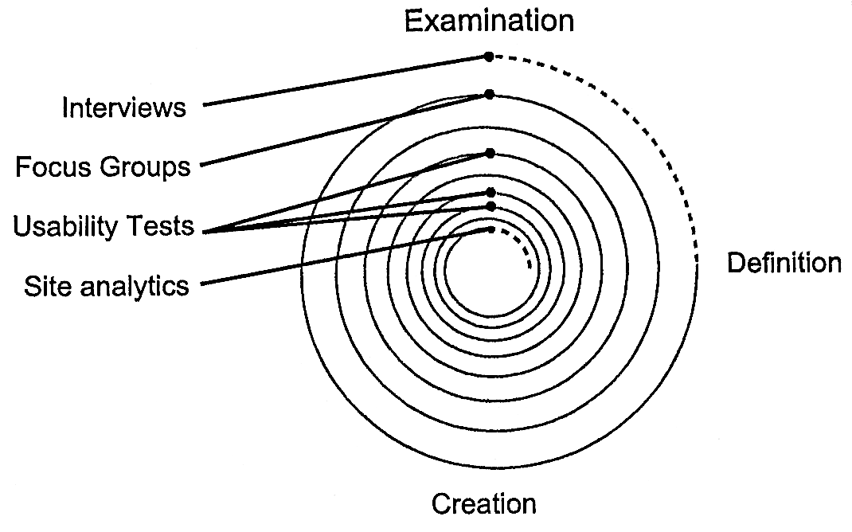
Design in Agile & Iterative Development
TIMELINE
Let the results of one research project answer questions asked by the ones before it and guide those that come after.
One cycle in the iterative development process. Creation is immediately followed by another cycle, beginning with examination. For a full example reference Elizabeth Goodman’s Observing the User Experience pg. 38.

Slide 19
Defining “Wireframe”
wireframing
--
A visual schematic, blueprint, or template of a screen or web page design. Focus is on screen content and behavior instead of fonts, colors, or graphics.
Rex Hartson

Slide 20
Wireframe Lifecycle
wireframing
--
Sketch
The rapid creation of freehand drawings expressing preliminary design ideas. Focus on concepts not details.
Sketches evoke thinking and ideas to arrive at a design.
Wireframe
A visual schematic, blueprint, or template of a screen or web page design.
Wireframes focus on content and behavior in a design. They can be strung together as a prototype for testing.
Mockup
Drafted designs that replicate the appearance of a live application.
Mockups focus on the visual aspects of a screen or web page design. They can also strung together as a prototype for testing.

Slide 21
Wireframe Lifecycle
wireframing
--
Sketch
Wireframe
Mockup

Slide 22
Wireframing
Mockups
Wireframes allow us to iterate faster.
It provides a team the means to examine and consider more ideas for prototype creation and testing.
Sketches

Slide 23
Tools Used
wireframing
--
Wireframes
Mockups

Slide 24

Sketching & Ideation
Activity
Ideation is the start of conceptual design. It is inseparable from sketching and evaluation aimed at exploration of design ideas.
—Rex Hartson, The UX Book
Iterate to explore
Ideation involves exploration and calls for extensive iteration. If you are starting out with only two or three alternatives, you are not doing this right.
Separate creation from critique
Don’t hobble early design ideas with early cries of “that will never work.” Allow sessions to be free-flow and creative.
When critiquing, critique constructively
Instead of shooting down ideas, take parts that can be changed or interpreted differently and use them in better ways.
Assemble an open-minded team
Include people with a breadth of knowledge and skills. Gather a creative and open-minded team to maximize ideation.
The legendary IDEO shopping cart
https://www.youtube.com/watch?v=M66ZU2PCIcM

Slide 25

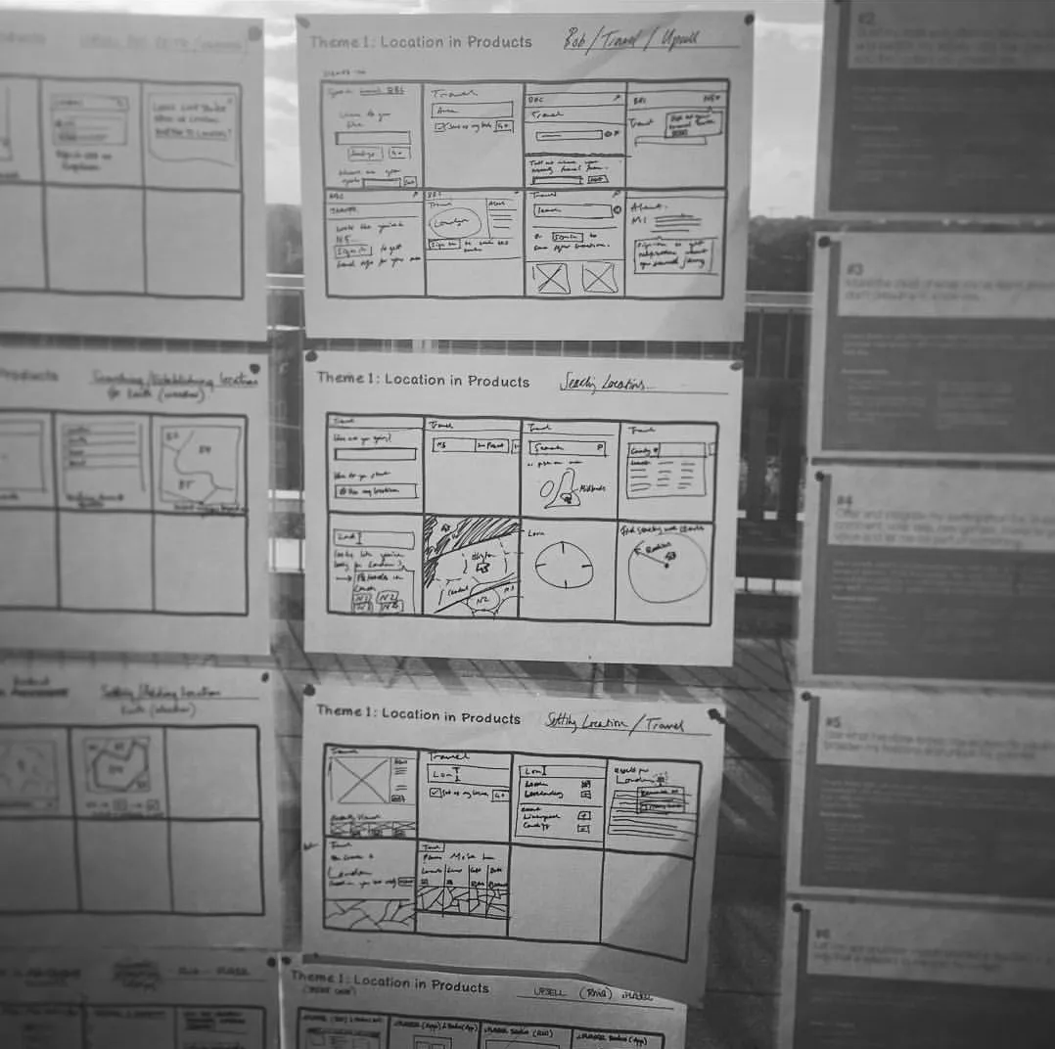
Crazy Eights
Exercise
The Challenge: Sketch eight distinct ideas in eight minutes.
Fast sketching forces you beyond your first idea (usually the least innovative)
Generates more solutions to your problem; strengths of each individual idea can be merged together
Easy, collaborative, and fun!

Slide 26
Crazy Eights 1. The Problem
Appendix
Blacksburg has commissioned you to create a new way for students to find local events and entertainment.
The new method can be anything (don’t constrain yourself to just a website/mobile app), so be creative!
Notes:
To create a product that must satisfy a diverse audience of users is to design for specific types of individuals with specific needs. It is not to make its functionality as broad as possible to accommodate the most people.
Elastic-user: conveniently bending and stretching to fit the opinions and presuppositions of whoever is talking.
Our goal should be to design products that appropriately meet the needs of real users.
The audience doesn’t extend beyond people like the designer. Self-referential design makes implementation-model products. They understand how it works, but few non-developers will concur.
Edge cases must be designed and programmed for, but they shouldn’t be the design focus. Let us ask “will Julie want to perform this operation very often? Will she ever?” with this we can prioritize functions with great clarity.

Slide 27
Crazy Eights 2. Ideate!
Appendix
Fold your paper into eight sections.
Each team member will sketch one unique idea into each rectangle.
A timer will be set for 6 minutes. When time’s up, pens go down.
Tip: Don’t stop moving your marker/pen or worry about a mistake, this is a sketch, so don’t panic about the details and move on to the next box!
Notes:
To create a product that must satisfy a diverse audience of users is to design for specific types of individuals with specific needs. It is not to make its functionality as broad as possible to accommodate the most people.
Elastic-user: conveniently bending and stretching to fit the opinions and presuppositions of whoever is talking.
Our goal should be to design products that appropriately meet the needs of real users.
The audience doesn’t extend beyond people like the designer. Self-referential design makes implementation-model products. They understand how it works, but few non-developers will concur.
Edge cases must be designed and programmed for, but they shouldn’t be the design focus. Let us ask “will Julie want to perform this operation very often? Will she ever?” with this we can prioritize functions with great clarity.

Slide 28
Crazy Eights 3. Brainstorm
Appendix
Let each team member take 3 minutes to talk through their ideas they generated and answer any questions.
Remember to focus on positives and strengths of each design, not weaknesses.
Notes:
To create a product that must satisfy a diverse audience of users is to design for specific types of individuals with specific needs. It is not to make its functionality as broad as possible to accommodate the most people.
Elastic-user: conveniently bending and stretching to fit the opinions and presuppositions of whoever is talking.
Our goal should be to design products that appropriately meet the needs of real users.
The audience doesn’t extend beyond people like the designer. Self-referential design makes implementation-model products. They understand how it works, but few non-developers will concur.
Edge cases must be designed and programmed for, but they shouldn’t be the design focus. Let us ask “will Julie want to perform this operation very often? Will she ever?” with this we can prioritize functions with great clarity.

Slide 29
Crazy Eights 4. Round 2
Appendix
Reflecting on the ideas in the group, repeat the Crazy Eights activity to mix your best thoughts together!
Tip: Feel free to spend a little more time fleshing out the current ideas instead of generating more than one solution.
Notes:
To create a product that must satisfy a diverse audience of users is to design for specific types of individuals with specific needs. It is not to make its functionality as broad as possible to accommodate the most people.
Elastic-user: conveniently bending and stretching to fit the opinions and presuppositions of whoever is talking.
Our goal should be to design products that appropriately meet the needs of real users.
The audience doesn’t extend beyond people like the designer. Self-referential design makes implementation-model products. They understand how it works, but few non-developers will concur.
Edge cases must be designed and programmed for, but they shouldn’t be the design focus. Let us ask “will Julie want to perform this operation very often? Will she ever?” with this we can prioritize functions with great clarity.

Slide 30
Crazy Eights 5. Wrap Up
Appendix
Everyone once again gets 3 minutes to explain their idea.
Each team member can vote for 2 sketched solutions they like.
Bump the sketch into a low-fidelity prototype and get to testing!
Notes:
To create a product that must satisfy a diverse audience of users is to design for specific types of individuals with specific needs. It is not to make its functionality as broad as possible to accommodate the most people.
Elastic-user: conveniently bending and stretching to fit the opinions and presuppositions of whoever is talking.
Our goal should be to design products that appropriately meet the needs of real users.
The audience doesn’t extend beyond people like the designer. Self-referential design makes implementation-model products. They understand how it works, but few non-developers will concur.
Edge cases must be designed and programmed for, but they shouldn’t be the design focus. Let us ask “will Julie want to perform this operation very often? Will she ever?” with this we can prioritize functions with great clarity.

Slide 31
Parting Gifts
Creative Confidence
Answers if you can be a designer, and how you can start thinking like one.
(Secretly homework)
The Design of Everyday Things
Introduction to why UX matters and human centered design.
The UX Book
Excellent high-level overview of everything UX curated by our very own Dr. Hartson.
About Face
Provides introductory HCI guidelines, goal-directed project planning, and how to use a persona the right way.
3-part series on how to become a UX designer
https://link.medium.com/xBTe4fsZSV

Slide 32
Q&A
Kaitlin Kallini
Senior UX Designer
Contact: kkallini@deloitte.com
Josh Kim
UX Designer
Contact: joshkim@deloitte.com
Mary Buckingham
Business Technology Analyst
Contact: mabuckingham@deloitte.com

Slide 33
Sound as UX
Appendix
An excerpt from Norman’s The design of Everyday things
“Sometimes things can't be made visible. Enter sound: sound can provide information available in no other way. Sound can tell us that things are working properly or that they need maintenance or repair. It can even save us from accidents. Consider the information provided by:
The click when the bolt on a door slides home
The "zzz" sound when a zipper works properly
The "tinny" sound when a door doesn't shut right
The roaring sound when a car muffler gets a hole
The rattle when things aren't secured
The whistle of a tea kettle when the water boils
The click when the toast pops up
The increase in pitch when a vacuum cleaner gets clogged
The indescribable change in sound when a complex piece of machinery starts to have problems
Many devices do use sound, but only for signals. Simple sounds, such as buzzers, bells, or tones. Computers use bleeping, whining, and clicking sounds. This use of sound is valuable and serves an
important function, but it is very limited in power; it is as if the use of visual cues were limited to different colored, flashing lights. We could use sound for much more communication than we do.
These days computers produce several sounds, and keypads, microwave ovens, and telephones beep and burp. These are not naturalistic sounds; they do not convey hidden information. When used properly, a beep can assure you that you've pressed a button, but the sound is s as annoying as informative. Sounds should be generated so as to give information about the source. They should convey something about the actions that are taking place, actions that matter to the user.
If they are to be useful, sounds must be generated intelligently, with an understanding of the natural relationship between the sounds and the information to be conveyed. Sounds on artificial devices should be as useful as sounds in the real world. Gaver has proposed that sound could play an important role in computer-based applications. Here, rich, naturalistic sounds could serve as auditory icons, caricatures of naturally occurring sounds that could provide information about the concepts being represented not easily conveyed in other ways.
You have to be very careful with sound, however. It easily becomes cute rather than useful. It can annoy and distract as easily as it can aid….Just as the presence of sound can serve a useful role in providing feedback about events, the absence of sound can lead to the same kinds of difficulties we have already encountered from a lack of feedback. The absence of sound can mean an absence of information, and if feedback from an action is expected to come from sound, silence can lead to problems.”

Slide 34
Stay in Touch
Appendix
Give us feedback
http://bit.ly/VTfeedback
Follow us on instagram
Deloitte GPS: @greendotgps Deloitte DMV: @greendotdmv
Get a 1 on 1 coffee chat with a Deloitte Hokie
http://bit.ly/D1on1VT2019
Email us
Maxie Keeler, Consulting Recruiter MKeeler@deloitte.com
Join our Spring Picnic
Deloitte Spring Picnic Thursday, 04/18, 6-8PM, Virginia Tech Inn

